Slide 1
Leadership & Implementation Teams
NCIC-TP Implementation Support
Raleigh/Wake County Triple P
Friday, April 7th, 2017

Slide 2
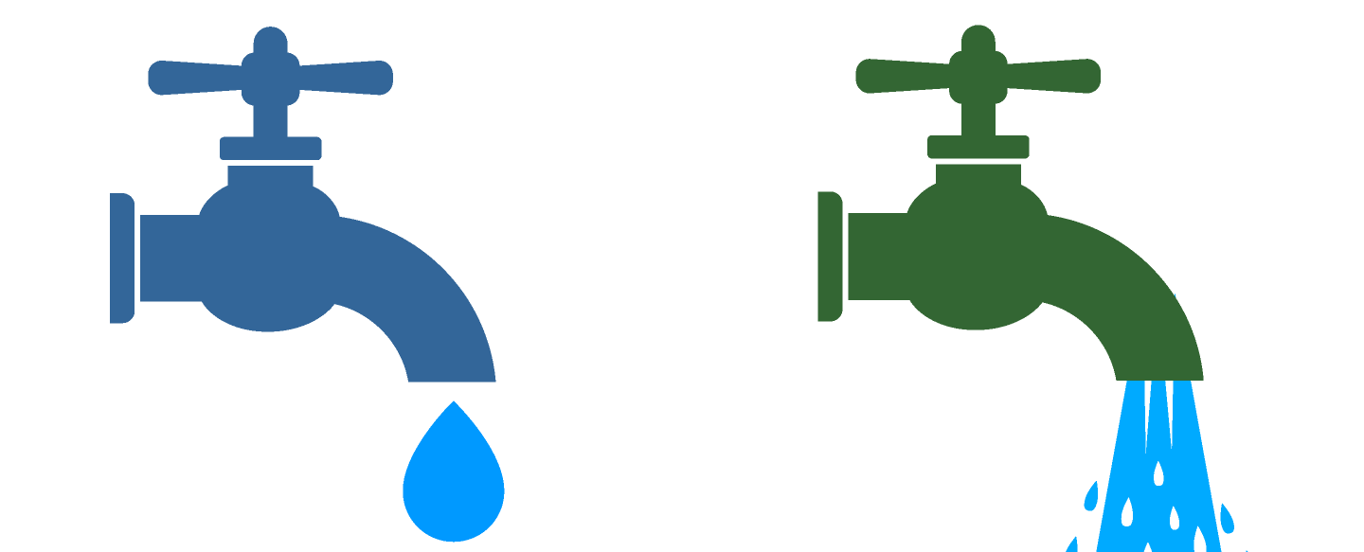

Co-Creation
Partner Support
Local Implementation
Triple P System
Optimization
Population-level
Outcomes
Capacity
Performance
Service agency leadership & staff
State/local funders & policymakers
Triple P America
Intermediary organizations
Local community members
Triple P developers & researchers
Leadership & implementation teams
Workforce development infrastructure
Quality & outcome monitoring system
Media
& networking capacity
Leading & supporting implementation
Developing confident
& competent practitioners
Gathering, analyzing,
& reporting data
System-wide learning
& improvement
Mobilizing knowledge
& behavior change
Accessibility
System alignment
Feasibility
Appropriateness
Fidelity
  Adherence
  Quality
  Caregiver engagement
  Dosage
Acceptability
Reach
Cost
Sustainability
State Triple P evaluation indicators
Other selected child wellbeing indicators
Other selected family wellbeing indicators
Selected community wellbeing indicators
Sustainment

Slide 3
Why is this important?

Slide 4
TPIE Findings: County Coalition Outcomes
Stronger countywide implementation capacity (particularly the Coalition Implementation Team) was observed to be associated with:
Higher rate of agency continuation
Higher rate of practitioner continuation
Higher rate of practitioners’ use of Triple P
Broader reach of Triple P to county children and families
Notes:
Aldridge, W. A., II, Murray, D. W., Prinz, R. J., & Veazey, C. A. (2016, January). Final Report and Recommendations: The Triple P Implementation Evaluation, Cabarrus and Mecklenburg Counties, NC. Chapel Hill: Frank Porter Graham Child Development Institute, The University of North Carolina.

Slide 5
TPIE Findings: Agencies’ Continuation
Several agency-level factors were statistically associated with agencies’ continuation:
Having stronger agency leadership and implementation teams
A more favorable agency implementation climate for Triple P
Having more than one Triple P practitioner
Having more formal agency sustainability plans in place (e.g., documented)
Notes:
Aldridge, W. A., II, Murray, D. W., Prinz, R. J., & Veazey, C. A. (2016, January). Final Report and Recommendations: The Triple P Implementation Evaluation, Cabarrus and Mecklenburg Counties, NC. Chapel Hill: Frank Porter Graham Child Development Institute, The University of North Carolina.

Slide 6
TPIE Findings:
Service Agency Capacity & Practitioner Fidelity
Agency Leadership & Implementation Team Capacity
Agency Implementation Infrastructure & Practices
Practitioner Adherence to Triple P Session Protocols
These relationships are not only significant, but characterized by
moderate to large effect sizes!

Slide 7
Program Sustainability
Group Homes adopting EBPs:
Where are they spending their resources?
100
90
80
70
Operating 6+ Yrs.
60
50
40
N = 219
30
20
10
N = 84
0
Practitioner Development
Organization Development
Fixsen, Blase, Timbers, & Wolf (2001)
Notes:
Fixsen, D. L., Blase, K. A., Timbers, G. D., & Wolf, M. M. (2001). In search of program implementation: 792 replications of the Teaching-Family Model. In G. A. Bernfeld, D. P. Farrington & A. W. Leschied (Eds.), Offender rehabilitation in practice: Implementing and evaluating effective programs (pp. 149-166). London: Wiley.

Slide 8
Function Before Form!

Slide 9
Active Implementation & Scaling Functions
Leadership & Management
Executive | Demonstrate commitment Create and nurture appropriate opportunities for change
Cross-System | Select and align Triple P interventions and coalition agencies Recommend policy and practice solutions Communicate changes and successes
Day-to-Day | Ensure buy-in and readiness for stage-based work Organize, align, and sustain the implementation infrastructure Actively use data and other information for continuous improvement
Aldridge, Boothroyd, Fleming, Lofts-Jarboe, Morrow, Ritchie, & Sebian (2016)
Notes:
Aldridge, W. A., II, Boothroyd, R. I., Fleming, W. O., Lofts Jarboe, K., Morrow, J., Ritchie, G. F., & Sebian, J. (2016). Transforming community prevention systems for sustained impact: Embedding active implementation and scaling functions. Translational Behavioral Medicine, 6, 135-144. doi:10.1007/s13142-015-0351-y
LEADERSHIP:
State Implementation and Scaling-up of Evidence-based Practices Center (n.d.). Module 3: Implementation teams. Retrieved from FPG Child Development Institute, University of North Carolina, Active Implementation Hub website: http://implementation.fpg.unc.edu/module-3.
Panzano and colleagues (2004) found that second-order leadership is important in the early stages of implementation of an effective innovation, and later on first-order leadership is essential to embedding implementation functions and roles into organization and system structures.
Panzano, P. C., Seffrin, B., Chaney-Jones, S., Roth, D., Crane-Ross, D., Massatti, R., et al. (2004). The innovation diffusion and adoption research project (IDARP). In D. Roth & W. Lutz (Eds.), New research in mental health (Vol. 16, pp. 78-89). Columbus, OH: Ohio Department of Mental Health Office of Program Evaluation and Research.
Darling-Hammond & McLaughlin (1995) outline approaches to “top down support for bottom up reform.”
Darling-Hammond, L., & McLaughlin, M. W. (1995). Policies that support professional development in an era of reform. Phi Delta Kappan, 76, 642-645.
Of the 21 leadership skills identified by Marzano and colleagues, teacher supervision and evaluation, staff development, and quality control were essential leadership traits related to first order change. These leadership skills overlap completely with the Implementation Drivers described in a separate Active Implementation module.
Marzano, Waters, and McNulty (2005). School leadership that works: From research to results. Alexandria, VA: Association for Supervision and Curriculum Development (ASCD).
Fixsen, D., Blase, K., Metz, A., & Van Dyke, M. (2013). Statewide implementation of evidence-based programs. Exceptional Children (Special Issue), 79, 213-230.
Metz, A., & Bartley, L. (2012). Active Implementation Frameworks for Program Success. Zero to Three, 32, 11-18.
IMPEMENTATION TEAMS:
State Implementation and Scaling-up of Evidence-based Practices Center (n.d.). Module 3: Implementation teams. Retrieved from FPG Child Development Institute, University of North Carolina, Active Implementation Hub website: http://implementation.fpg.unc.edu/module-3.
Fixsen, D., Blase, K., Metz, A., & Van Dyke, M. (2013). Statewide implementation of evidence-based programs. Exceptional Children (Special Issue), 79, 213-230.
Metz, A., & Bartley, L. (2012). Active Implementation Frameworks for Program Success. Zero to Three, 32, 11-18.
Fixsen, D. L., Blase, K. A., Timbers, G. D., & Wolf, M. M. (2001). In search of program implementation: 792 replications of the Teaching-Family Model. In G. A. Bernfeld, D. P. Farrington & A. W. Leschied (Eds.), Offender rehabilitation in practice: Implementing and evaluating effective programs (pp. 149-166). London: Wiley.
Higgins, M., Weiner, J., & Young, L. (2012). Implementation teams: A new lever for organizational change. Journal of Organizational Behavior. Retrieved from doi:10.1002/job.1773
Klest SK. Clustering practitioners within service organizations may improve implementation outcomes for evidence-based programs. Zeitschrift fr Psychologie. 2014;222:30-36.
Saldana, L., & Chamberlain, P. (2012). Supporting implementation: The role of community development teams to build infrastructure. American Journal of Community Psychology. doi: 10.1007/s10464-012-9503-0
Aarons, G. A., Green, A. E., Palinkas, L. A., Self-Brown, S., Whitaker, D. J., Lutzker, J. R., . . . Chaffin, M. J. (2012). Dynamic adaptation process to implement an evidence-based child maltreatment intervention. Implementation Science, 7. doi: 10.1186/1748-5908-7-32

Slide 10
Active Implementation & Scaling Functions
Leadership and Management
Executive | Demonstrate ongoing commitment to the implementation and scaling of Triple P to achieve intended outcomes for community children and families. Demonstrate ongoing commitment to community and tribal partnerships to ensure cultural values and experiences are incorporated into practice and system changes. Create appropriate opportunities for change within the community prevention system. Nurture systems changes once they are underway.
Aldridge, Boothroyd, Fleming, Lofts-Jarboe, Morrow, Ritchie, & Sebian (2016)
Notes:
Aldridge, W. A., II, Boothroyd, R. I., Fleming, W. O., Lofts Jarboe, K., Morrow, J., Ritchie, G. F., & Sebian, J. (2016). Transforming community prevention systems for sustained impact: Embedding active implementation and scaling functions. Translational Behavioral Medicine, 6, 135-144. doi:10.1007/s13142-015-0351-y

Slide 11
Active Implementation & Scaling Functions
Leadership & Management
Executive | Demonstrate commitment Create and nurture appropriate opportunities for change
Cross-System | Select and align Triple P interventions and coalition agencies Recommend policy and practice solutions Communicate changes and successes
Day-to-Day | Ensure buy-in and readiness for stage-based work Organize, align, and sustain the implementation infrastructure Actively use data and other information for continuous improvement
Aldridge, Boothroyd, Fleming, Lofts-Jarboe, Morrow, Ritchie, & Sebian (2016)
Notes:
Aldridge, W. A., II, Boothroyd, R. I., Fleming, W. O., Lofts Jarboe, K., Morrow, J., Ritchie, G. F., & Sebian, J. (2016). Transforming community prevention systems for sustained impact: Embedding active implementation and scaling functions. Translational Behavioral Medicine, 6, 135-144. doi:10.1007/s13142-015-0351-y

Slide 12
Active Implementation & Scaling Functions
Leadership and Management
Cross-System | Select Triple P interventions to respond to identified community needs. Ensure that Triple P interventions are teachable, learnable, doable, and assessable in practice. Align Triple P interventions under a common approach to implementation. Select and align community service agencies to attain community-wide reach. Review and recommend solutions to shared implementation barriers and system needs, incorporating diverse perspectives. Facilitate and normalize communication about systems changes and successes among and across all stakeholders and community members.
Aldridge, Boothroyd, Fleming, Lofts-Jarboe, Morrow, Ritchie, & Sebian (2016)
Notes:
Aldridge, W. A., II, Boothroyd, R. I., Fleming, W. O., Lofts Jarboe, K., Morrow, J., Ritchie, G. F., & Sebian, J. (2016). Transforming community prevention systems for sustained impact: Embedding active implementation and scaling functions. Translational Behavioral Medicine, 6, 135-144. doi:10.1007/s13142-015-0351-y

Slide 13
Active Implementation & Scaling Functions
Leadership & Management
Executive | Demonstrate commitment Create and nurture appropriate opportunities for change
Cross-System | Select and align Triple P interventions and coalition agencies Recommend policy and practice solutions Communicate changes and successes
Day-to-Day | Ensure buy-in and readiness for stage-based work Organize, align, and sustain the implementation infrastructure Actively use data and other information for continuous improvement
Aldridge, Boothroyd, Fleming, Lofts-Jarboe, Morrow, Ritchie, & Sebian (2016)
Notes:
Aldridge, W. A., II, Boothroyd, R. I., Fleming, W. O., Lofts Jarboe, K., Morrow, J., Ritchie, G. F., & Sebian, J. (2016). Transforming community prevention systems for sustained impact: Embedding active implementation and scaling functions. Translational Behavioral Medicine, 6, 135-144. doi:10.1007/s13142-015-0351-y

Slide 14
Active Implementation & Scaling Functions
Leadership and Management
Day-to-Day | Assess and create ongoing “buy-in” and readiness across the community. Install, ensure aligned operation of, and sustain implementation infrastructure and best practices. Develop and implement action plans to manage stage-based work. Use data, including fidelity and outcome data, for continuous improvement. Involve key system and community partners, including parents and families, in implementation activities and decision-making for system improvement. Organize and direct the day-to-day flow of information to support implementation. Identify and address implementation barriers and ensure the spread of solutions to support successful implementation.
Aldridge, Boothroyd, Fleming, Lofts-Jarboe, Morrow, Ritchie, & Sebian (2016)
Notes:
Aldridge, W. A., II, Boothroyd, R. I., Fleming, W. O., Lofts Jarboe, K., Morrow, J., Ritchie, G. F., & Sebian, J. (2016). Transforming community prevention systems for sustained impact: Embedding active implementation and scaling functions. Translational Behavioral Medicine, 6, 135-144. doi:10.1007/s13142-015-0351-y

Slide 15
Active Implementation & Scaling Functions
Leadership & Management
Executive | Demonstrate commitment Create and nurture appropriate opportunities for change
Cross-System | Select and align Triple P interventions and coalition agencies Recommend policy and practice solutions Communicate changes and successes
Day-to-Day | Ensure buy-in and readiness for stage-based work Organize, align, and sustain the implementation infrastructure Actively use data and other information for continuous improvement
Aldridge, Boothroyd, Fleming, Lofts-Jarboe, Morrow, Ritchie, & Sebian (2016)
Notes:
Aldridge, W. A., II, Boothroyd, R. I., Fleming, W. O., Lofts Jarboe, K., Morrow, J., Ritchie, G. F., & Sebian, J. (2016). Transforming community prevention systems for sustained impact: Embedding active implementation and scaling functions. Translational Behavioral Medicine, 6, 135-144. doi:10.1007/s13142-015-0351-y

Slide 16
Form Follows Function and is
Responsive to Local Context

Slide 17
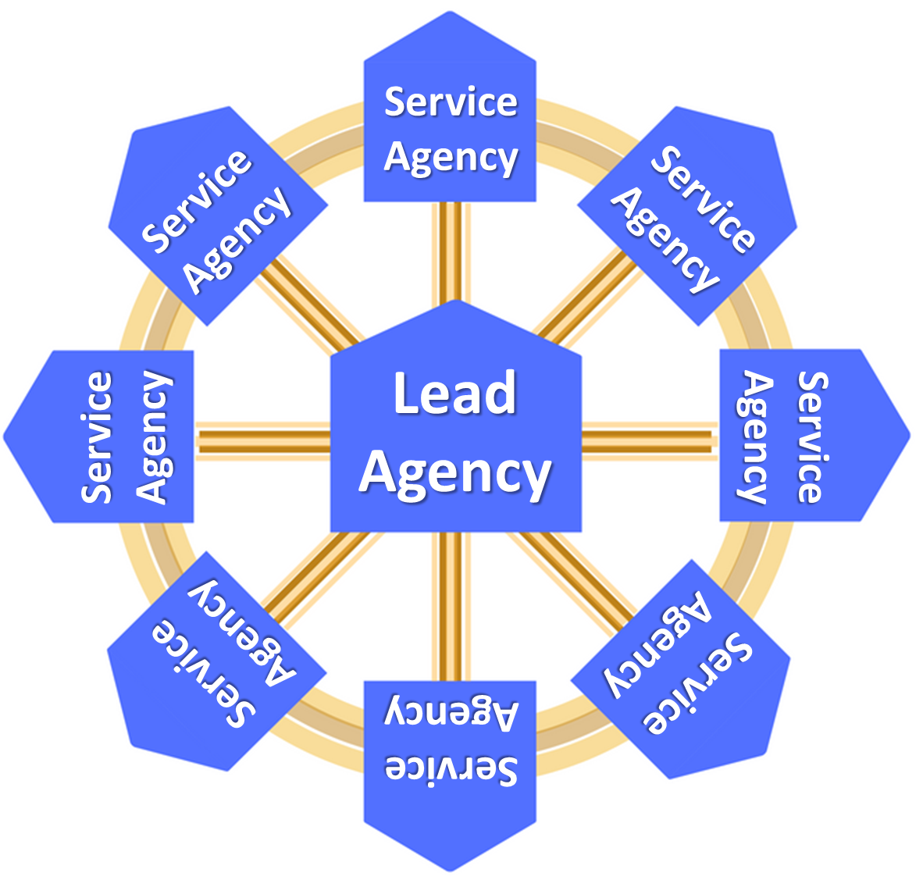
Community Connections Committee
Key Parents/Families, Community Leaders, Funders, & Policymakers
Raleigh/Wake Triple P Coalition Leadership Team
Service Agency Executive Leaders & Implementation Coordinators
As Needed
As Needed
Learning Committee
inc. Parents/Families
Coalition Implementation Team
Ashley, Aprielle, TBH, Mary, ?
Media & Networking Committee
inc. Parents/Families
Community Triple P Coalition Characteristics
Common agenda
Shared measurement
Mutually reinforcing activities
Continuous communication
Project Enlightenment serves as lead agency
  Facilitating dialogue between partners
  Providing overall strategic direction
  Managing data collection and analysis
  Handling communications
  Coordinating community outreach
  Mobilizing funding
Support
Feedback
Notes:
Raleigh Contextualized Slide

Slide 18
Executive Functions
&
Cross-System Functions
Raleigh/Wake Triple P Coalition Leadership Team
Service Agency Executive Leaders & Implementation Coordinators
As Needed
As Needed
Learning Committee
inc. Parents/Families
Coalition Implementation Team
Ashley, Aprielle, TBH, Mary, ?
Media & Networking Committee
inc. Parents/Families
Day-to-Day Functions
Collective Impact’s backbone organization functions are
fairly embedded within these day-to-day functions at this level
Facilitating dialogue between partners
Providing overall strategic direction
Managing data collection and analysis
Handling communications
Coordinating community outreach
Mobilizing funding
Notes:
Raleigh Contextualized Slide

Slide 19
Executive Functions
Cross-Agency Functions
Day-to-Day Functions

Slide 20
Ensuring Close Alignment Between Leadership and Implementation Teams

Slide 21

Close Alignment of Leadership
& Implementation Teams
Establishing implementation capacity and performance requires changes to system and agency:
  Functions
  Roles
  Structures
System and agency leadership must remain visibly and continually engaged to:
  Create appropriate opportunities for change
  Nurture systems changes once they are underway
Notes:
LEADERSHIP:
Panzano and colleagues (2004) found that second-order leadership is important in the early stages of implementation of an effective innovation, and later on first-order leadership is essential to embedding implementation functions and roles into organization and system structures.
Panzano, P. C., Seffrin, B., Chaney-Jones, S., Roth, D., Crane-Ross, D., Massatti, R., et al. (2004). The innovation diffusion and adoption research project (IDARP). In D. Roth & W. Lutz (Eds.), New research in mental health (Vol. 16, pp. 78-89). Columbus, OH: Ohio Department of Mental Health Office of Program Evaluation and Research.
Darling-Hammond & McLaughlin (1995) outline approaches to “top down support for bottom up reform.”
Darling-Hammond, L., & McLaughlin, M. W. (1995). Policies that support professional development in an era of reform. Phi Delta Kappan, 76, 642-645.
Of the 21 leadership skills identified by Marzano and colleagues, teacher supervision and evaluation, staff development, and quality control were essential leadership traits related to first order change. These leadership skills overlap completely with the Implementation Drivers described in a separate Active Implementation module.
Marzano, Waters, and McNulty (2005). School leadership that works: From research to results. Alexandria, VA: Association for Supervision and Curriculum Development (ASCD).
IMPEMENTATION TEAMS:
State Implementation and Scaling-up of Evidence-based Practices Center (n.d.). Module 3: Implementation teams. Retrieved from FPG Child Development Institute, University of North Carolina, Active Implementation Hub website: http://implementation.fpg.unc.edu/module-3.
Fixsen, D., Blase, K., Metz, A., & Van Dyke, M. (2013). Statewide implementation of evidence-based programs. Exceptional Children (Special Issue), 79, 213-230.
Metz, A., & Bartley, L. (2012). Active Implementation Frameworks for Program Success. Zero to Three, 32, 11-18.
Fixsen, D. L., Blase, K. A., Timbers, G. D., & Wolf, M. M. (2001). In search of program implementation: 792 replications of the Teaching-Family Model. In G. A. Bernfeld, D. P. Farrington & A. W. Leschied (Eds.), Offender rehabilitation in practice: Implementing and evaluating effective programs (pp. 149-166). London: Wiley.
Higgins, M., Weiner, J., & Young, L. (2012). Implementation teams: A new lever for organizational change. Journal of Organizational Behavior. Retrieved from doi:10.1002/job.1773
Klest SK. Clustering practitioners within service organizations may improve implementation outcomes for evidence-based programs. Zeitschrift fr Psychologie. 2014;222:30-36.
Saldana, L., & Chamberlain, P. (2012). Supporting implementation: The role of community development teams to build infrastructure. American Journal of Community Psychology. doi: 10.1007/s10464-012-9503-0
Aarons, G. A., Green, A. E., Palinkas, L. A., Self-Brown, S., Whitaker, D. J., Lutzker, J. R., . . . Chaffin, M. J. (2012). Dynamic adaptation process to implement an evidence-based child maltreatment intervention. Implementation Science, 7. doi: 10.1186/1748-5908-7-32

Slide 22
Top Down Support for Bottom Up Reform
Structure or Process | Assuring Support
Coalition Leadership Team
Coalition Implementation Team
Agency Leadership
Agency Implementation Team
Triple P Practitioners
Community Children & Families
Notes:
LEADERSHIP:
Panzano and colleagues (2004) found that second-order leadership is important in the early stages of implementation of an effective innovation, and later on first-order leadership is essential to embedding implementation functions and roles into organization and system structures.
Panzano, P. C., Seffrin, B., Chaney-Jones, S., Roth, D., Crane-Ross, D., Massatti, R., et al. (2004). The innovation diffusion and adoption research project (IDARP). In D. Roth & W. Lutz (Eds.), New research in mental health (Vol. 16, pp. 78-89). Columbus, OH: Ohio Department of Mental Health Office of Program Evaluation and Research.
Darling-Hammond & McLaughlin (1995) outline approaches to “top down support for bottom up reform.”
Darling-Hammond, L., & McLaughlin, M. W. (1995). Policies that support professional development in an era of reform. Phi Delta Kappan, 76, 642-645.
Of the 21 leadership skills identified by Marzano and colleagues, teacher supervision and evaluation, staff development, and quality control were essential leadership traits related to first order change. These leadership skills overlap completely with the Implementation Drivers described in a separate Active Implementation module.
Marzano, Waters, and McNulty (2005). School leadership that works: From research to results. Alexandria, VA: Association for Supervision and Curriculum Development (ASCD).
IMPEMENTATION TEAMS:
State Implementation and Scaling-up of Evidence-based Practices Center (n.d.). Module 3: Implementation teams. Retrieved from FPG Child Development Institute, University of North Carolina, Active Implementation Hub website: http://implementation.fpg.unc.edu/module-3.
Fixsen, D., Blase, K., Metz, A., & Van Dyke, M. (2013). Statewide implementation of evidence-based programs. Exceptional Children (Special Issue), 79, 213-230.
Metz, A., & Bartley, L. (2012). Active Implementation Frameworks for Program Success. Zero to Three, 32, 11-18.
Fixsen, D. L., Blase, K. A., Timbers, G. D., & Wolf, M. M. (2001). In search of program implementation: 792 replications of the Teaching-Family Model. In G. A. Bernfeld, D. P. Farrington & A. W. Leschied (Eds.), Offender rehabilitation in practice: Implementing and evaluating effective programs (pp. 149-166). London: Wiley.
Higgins, M., Weiner, J., & Young, L. (2012). Implementation teams: A new lever for organizational change. Journal of Organizational Behavior. Retrieved from doi:10.1002/job.1773
Klest SK. Clustering practitioners within service organizations may improve implementation outcomes for evidence-based programs. Zeitschrift fr Psychologie. 2014;222:30-36.
Saldana, L., & Chamberlain, P. (2012). Supporting implementation: The role of community development teams to build infrastructure. American Journal of Community Psychology. doi: 10.1007/s10464-012-9503-0
Aarons, G. A., Green, A. E., Palinkas, L. A., Self-Brown, S., Whitaker, D. J., Lutzker, J. R., . . . Chaffin, M. J. (2012). Dynamic adaptation process to implement an evidence-based child maltreatment intervention. Implementation Science, 7. doi: 10.1186/1748-5908-7-32

Slide 23
Cross-Agency State Leadership Team
NC Triple P
State Learning Collaborative
Feedback
Cascading
Logic Model of
Implementation Support
Support
Feedback
Triple P America
Support
Practitioners' Responsive & Effective Delivery of Triple P
Intermediary Organizations
Feedback
Parent and Family Wellbeing &
Self-Regulation
Support

Slide 24
Key considerations for developing and resourcing implementation teams

Slide 25

Considerations for Developing Implementation Teams
Teams are best started by repurposing existing teams and staff but can be newly formed if necessary
Core, manageable group of at least 3 members
  Coalition level: around 3.0 FTE across 5 or so team members.
  Agency level: 3 or so team members with formally recognized time (these individuals may wear multiple hats – leadership, implementation team, practitioner).
  Teams can tolerate turnover; they are sustainable even when the players come and go (Higgins, Weiner, & Young, 2012; Klest, 2014)

Slide 26
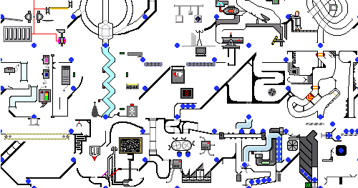
Considerations for Developing Implementation Teams: Coalition & Agency Context
Size
Complexity
Location of financial resources
Political environment
Community member involvement in implementation
Locations of authority and decision-making within the agency

Slide 27
Core Competencies within
Implementation Teams
Implementation teams (supporting day-to-day functions) have cross-team expertise in:
  Triple P (“fluency” at coalition-level; “proficiency” at agency-level)
  Effective implementation strategies and best practices (“fluency” at coalition-level; “proficiency” at agency-level)
  System/organizational change (adaptive leadership, communication, problem-solving)
  Improvement cycle methods (Plan-Do-Study-Act methods; particularly at coalition-level)
Notes:
27
State Implementation and Scaling-up of Evidence-based Practices Center (n.d.). Module 3: Implementation teams. Retrieved from FPG Child Development Institute, University of North Carolina, Active Implementation Hub website: http://implementation.fpg.unc.edu/module-3.
Fixsen, D., Blase, K., Metz, A., & Van Dyke, M. (2013). Statewide implementation of evidence-based programs. Exceptional Children (Special Issue), 79, 213-230.
Metz, A., & Bartley, L. (2012). Active Implementation Frameworks for Program Success. Zero to Three, 32, 11-18.
Fixsen, D. L., Blase, K. A., Timbers, G. D., & Wolf, M. M. (2001). In search of program implementation: 792 replications of the Teaching-Family Model. In G. A. Bernfeld, D. P. Farrington & A. W. Leschied (Eds.), Offender rehabilitation in practice: Implementing and evaluating effective programs (pp. 149-166). London: Wiley.
Higgins, M., Weiner, J., & Young, L. (2012). Implementation teams: A new lever for organizational change. Journal of Organizational Behavior. Retrieved from doi:10.1002/job.1773
Klest SK. Clustering practitioners within service organizations may improve implementation outcomes for evidence-based programs. Zeitschrift fr Psychologie. 2014;222:30-36.
Saldana, L., & Chamberlain, P. (2012). Supporting implementation: The role of community development teams to build infrastructure. American Journal of Community Psychology. doi: 10.1007/s10464-012-9503-0
Aarons, G. A., Green, A. E., Palinkas, L. A., Self-Brown, S., Whitaker, D. J., Lutzker, J. R., . . . Chaffin, M. J. (2012). Dynamic adaptation process to implement an evidence-based child maltreatment intervention. Implementation Science, 7. doi: 10.1186/1748-5908-7-32

Slide 28

Considerations and Core Competencies within Design Teams
May have larger membership
Include members from across the community coalition or system
Design teams (supporting cross-system functions) have cross-team expertise in:
  What’s happening with day-to-day management of implementation across the coalition
  The community’s network of service agencies and leaders
  The community’s portfolio of priority initiatives and system of Triple P programs
  Adaptive leadership and problem-solving
  System policy and practice design
  Communications
Notes:
28
State Implementation and Scaling-up of Evidence-based Practices Center (n.d.). Module 3: Implementation teams. Retrieved from FPG Child Development Institute, University of North Carolina, Active Implementation Hub website: http://implementation.fpg.unc.edu/module-3.
Fixsen, D., Blase, K., Metz, A., & Van Dyke, M. (2013). Statewide implementation of evidence-based programs. Exceptional Children (Special Issue), 79, 213-230.
Metz, A., & Bartley, L. (2012). Active Implementation Frameworks for Program Success. Zero to Three, 32, 11-18.
Fixsen, D. L., Blase, K. A., Timbers, G. D., & Wolf, M. M. (2001). In search of program implementation: 792 replications of the Teaching-Family Model. In G. A. Bernfeld, D. P. Farrington & A. W. Leschied (Eds.), Offender rehabilitation in practice: Implementing and evaluating effective programs (pp. 149-166). London: Wiley.
Higgins, M., Weiner, J., & Young, L. (2012). Implementation teams: A new lever for organizational change. Journal of Organizational Behavior. Retrieved from doi:10.1002/job.1773
Klest SK. Clustering practitioners within service organizations may improve implementation outcomes for evidence-based programs. Zeitschrift fr Psychologie. 2014;222:30-36.
Saldana, L., & Chamberlain, P. (2012). Supporting implementation: The role of community development teams to build infrastructure. American Journal of Community Psychology. doi: 10.1007/s10464-012-9503-0
Aarons, G. A., Green, A. E., Palinkas, L. A., Self-Brown, S., Whitaker, D. J., Lutzker, J. R., . . . Chaffin, M. J. (2012). Dynamic adaptation process to implement an evidence-based child maltreatment intervention. Implementation Science, 7. doi: 10.1186/1748-5908-7-32

Slide 29

Considerations and Core Competencies within Leadership Teams
Usually includes agency leaders with executive authority over Triple P
Leadership teams (supporting executive functions) have cross-team abilities for:
  Adaptive leadership
  Innovation and ongoing learning
  Strong communication of vision and mission
  Social modeling
  Recognition and compassion
  Teaming with those leading Triple P implementation work
  Partnering with system and community partners
Notes:
29
State Implementation and Scaling-up of Evidence-based Practices Center (n.d.). Module 3: Implementation teams. Retrieved from FPG Child Development Institute, University of North Carolina, Active Implementation Hub website: http://implementation.fpg.unc.edu/module-3.
Fixsen, D., Blase, K., Metz, A., & Van Dyke, M. (2013). Statewide implementation of evidence-based programs. Exceptional Children (Special Issue), 79, 213-230.
Metz, A., & Bartley, L. (2012). Active Implementation Frameworks for Program Success. Zero to Three, 32, 11-18.
Fixsen, D. L., Blase, K. A., Timbers, G. D., & Wolf, M. M. (2001). In search of program implementation: 792 replications of the Teaching-Family Model. In G. A. Bernfeld, D. P. Farrington & A. W. Leschied (Eds.), Offender rehabilitation in practice: Implementing and evaluating effective programs (pp. 149-166). London: Wiley.
Higgins, M., Weiner, J., & Young, L. (2012). Implementation teams: A new lever for organizational change. Journal of Organizational Behavior. Retrieved from doi:10.1002/job.1773
Klest SK. Clustering practitioners within service organizations may improve implementation outcomes for evidence-based programs. Zeitschrift fr Psychologie. 2014;222:30-36.
Saldana, L., & Chamberlain, P. (2012). Supporting implementation: The role of community development teams to build infrastructure. American Journal of Community Psychology. doi: 10.1007/s10464-012-9503-0
Aarons, G. A., Green, A. E., Palinkas, L. A., Self-Brown, S., Whitaker, D. J., Lutzker, J. R., . . . Chaffin, M. J. (2012). Dynamic adaptation process to implement an evidence-based child maltreatment intervention. Implementation Science, 7. doi: 10.1186/1748-5908-7-32

Slide 30
Tools in the Bag for Team Structures:
Terms of Reference &
Linking Communication Protocols

Slide 31
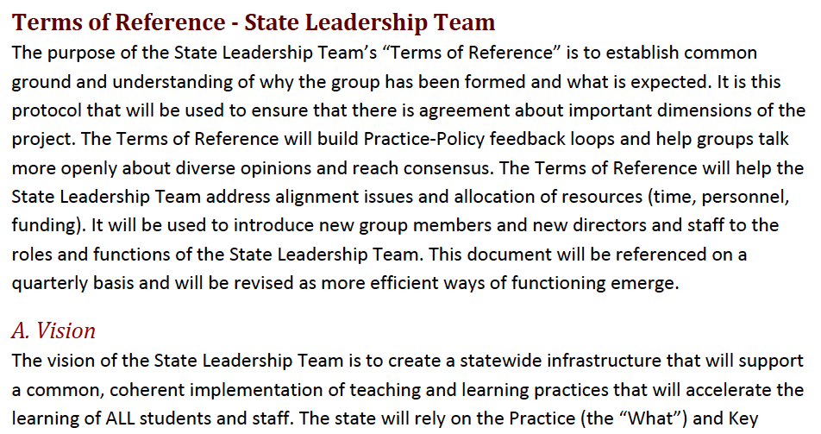
Terms of Reference
A written organizational document that creates alignment, structure, and transparency
Similar concepts:
  MOU
  MOA
  Charter

Slide 32
Terms of Reference Ensure…
Clarity of the role of the team and membership
Agreed-upon objectives and ways of work
Time to work and meet
Timely access to data about child and family outcomes and implementation outcomes (e.g., fidelity, reach, feasibility, etc…)
Communication links with leaders and other implementation teams and support structures (e.g., other implementation teams across the coalition, community partners, recruitment and selection committees, Triple P America, community Triple P coaches, local evaluators)

Slide 33
Teams Terms of Reference
Component | Guiding Questions
Vision | What would success of Triple P implementation look like?
Mission | What is this Team’s role in getting to the Vision?
Objectives/Functions | [often informed by Leadership & Management functions]
Values & Principles | What informs how this Team works together?
Characteristics | What core competencies are needed for this Team’s work?
Membership | Who brings the competencies? How/at what level do they participate?
Communications | How does this Team communicate with each other & others?
Resources | What resources are available and needed to support this Team’s work?
Deliverables | What are concrete products of this Team’s work?
Authority/Boundaries | How is this Team connected with others? Where does our role end?

Slide 34
Linking Communication Protocols for Teams
Communicate progress and celebrate success throughout an agency and the larger coalition
Report systemic barriers that are preventing or hindering Triple P implementation and:
  Should be resolved by one of the teams involved in the immediate communication, or
  Need to be moved ‘up the line’ or ‘handed off’ to the team or support staff that can best address the barrier
Report on actions taken to resolve or address past issues
Revisit past decisions and agreements periodically to ensure that solutions are still functional

Slide 35
Linking Communication Protocols for Teams
Written communication plan that creates alignment, sets expectations, and enables transparency
Ensure:
  Transparent feedback process
  Development of a hospitable environment
  Practice-Policy communication cycles for continuous quality improvement
  System alignment (avoids silos or fragmentation)
    Vertically (practice to policy)
    Horizontally (key partners and implementation support staff such as trainers, coaches, data specialists, etc.)

Slide 36

